Slide 1


Moment in 2d and 3d
Lecturer 2

Slide 2
Items
Moment of a Force—Scalar Formulation.
Moment of a Force—Vector Formulation.
Moment of a Force about a Specified Axis.
Moment of a Couple.
Equivalent Couples
Simplification of a Force and Couple System
Reduction to a Wrench

Slide 3
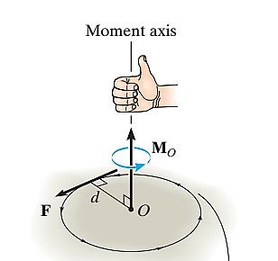
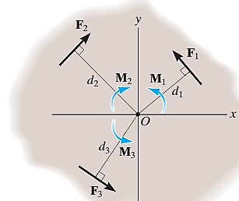
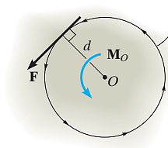
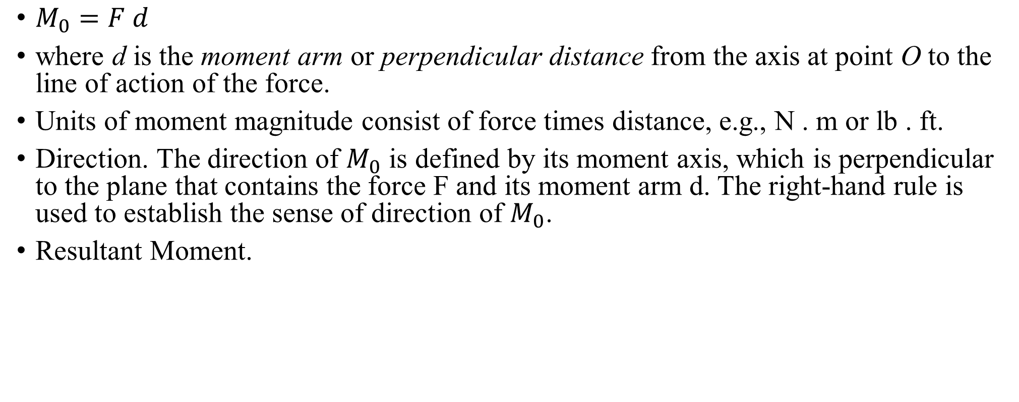
Moment of a Force—Scalar Formulation in 2d
$M_{0}=F d$
where d is the moment arm or perpendicular distance from the axis at point O to the line of action of the force.
Units of moment magnitude consist of force times distance, e.g., N . m or lb . ft.
Direction. The direction of $M_{0}$ is defined by its moment axis, which is perpendicular to the plane that contains the force F and its moment arm d. The right-hand rule is used to establish the sense of direction of $M_{0}$.
Resultant Moment.

Slide 4
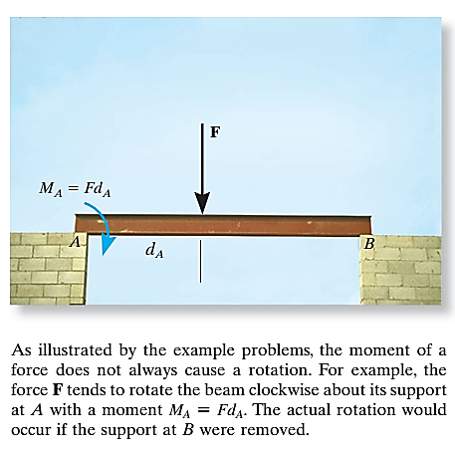
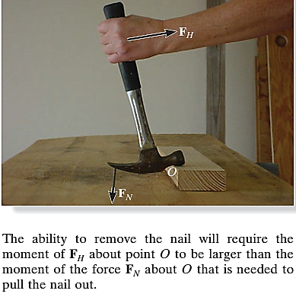

Slide 5
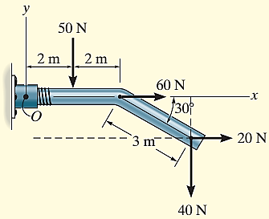

Example1: Determine the resultant moment of the four forces acting on the rod shown in Fig. about point O.
Solution:
$M_{0}=−50∗2$
$−40∗(4+3 cos 30)+$
$20∗3sin 30=$
=$−334=334$

Slide 6
Moment of a Force—Vector Formulation
choose a point located on the line action of the force
The moment arm is the vector directed from the moment impact point and that point in step 1
Using a cross product to find the moment about that
determined point

Slide 7

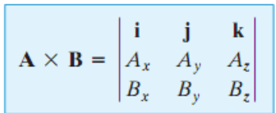
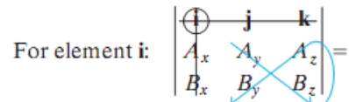

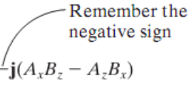
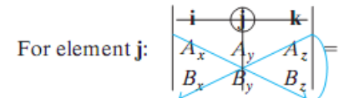
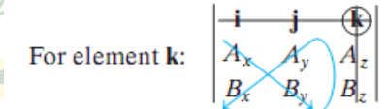



Slide 8
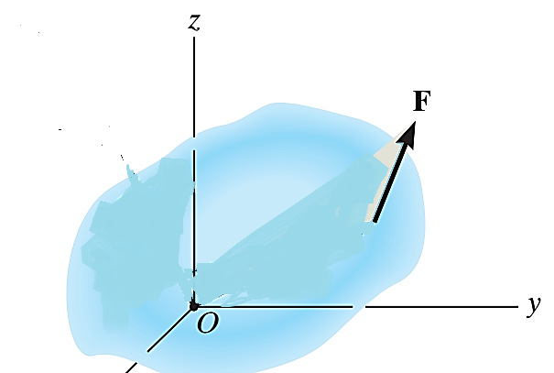


Moment of a Force—Vector Formulation

Slide 9
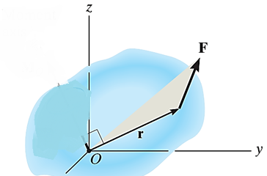
Moment of a force

Slide 10
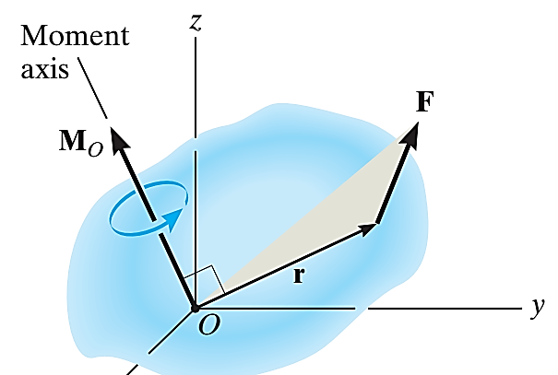
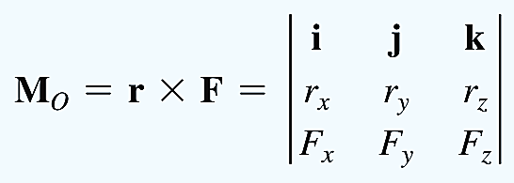
Moment a bout point

Slide 11
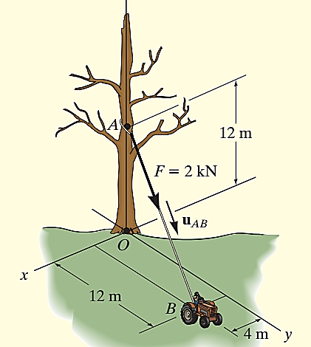
Ex2: Determine the moment produced by the force F in shown Fig. about point O. Express the result as a Cartesian vector.

Slide 12
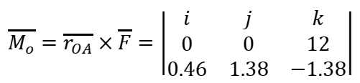



Ex2: Determine the moment produced by the force F in shown Fig. about point O. Express the result as a Cartesian vector.
$$\overset{⃑}{r_{A}}=12 \hat{k}$$
$$\overset{⃑}{F}=F∗{\hat{u}}_{AB}=2\frac{4\hat{i}+12\hat{j}−12\hat{k}}{\sqrt{4^{2}+{12}^{2}+{12}^{2}}}$$
= $0.4588\hat{i}+1.376\hat{j}−1.376\hat{k}$
(0,0,12)
(0,0,0)
(4,12,0)

Slide 13
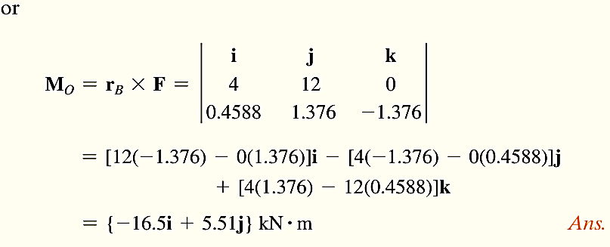
Ex2: Determine the moment produced by the force F in shown Fig. about point O. Express the result as a Cartesian vector.
$$\overset{⃑}{r_{A}}=12 \hat{k}$$
$$\overset{⃑}{F}=F∗{\hat{u}}_{AB}=2\frac{4\hat{i}+12\hat{j}−12\hat{k}}{\sqrt{4^{2}+{12}^{2}+{12}^{2}}}$$
= $0.4588\hat{i}+1.376\hat{j}−1.376\hat{k}$
(0,0,12)
(0,0,0)
(4,12,0)

Slide 14


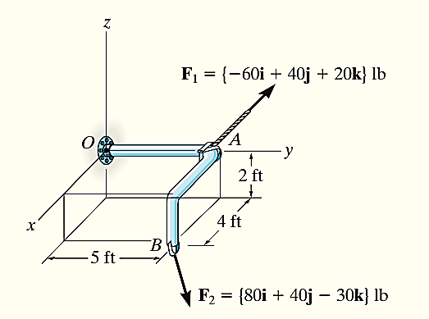

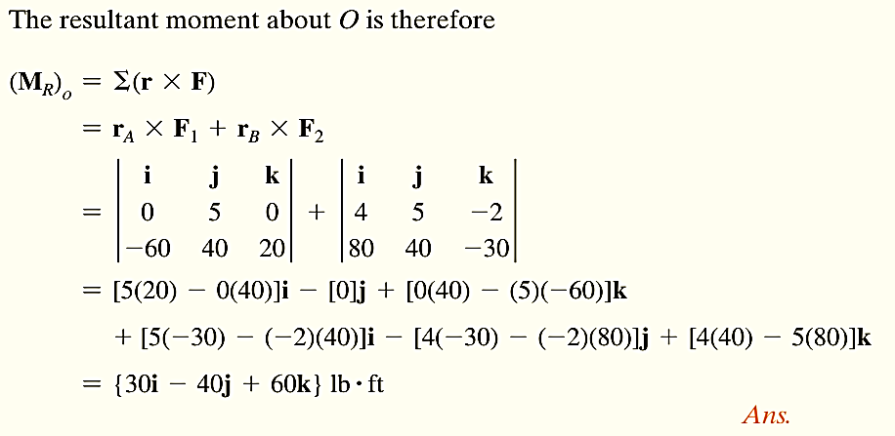
Ex3 : Two forces act on the rod shown in Fig. Determine the resultant moment they create about the flange at O. Express the result as a Cartesian vector.
Position vectors are directed from point O to each force as shown in Fig. These vectors are
(0,5,0)
(4,5,-2)

Slide 15
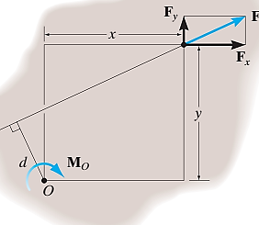
Varignon’s theorem
It states that the moment of a force about a point is equal to the sum of the moments of the components of the force about the point.

Slide 16
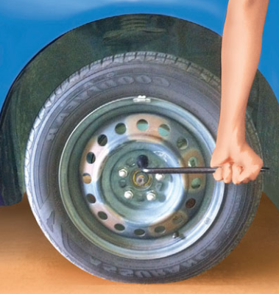
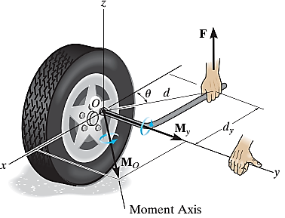

Moment of a Force about a Specified Axis x,y,z.
Scalar Analysis. the moment arm perpendicular distance from the axis to the line of action of the force $×$ magnitude of the force

Slide 17
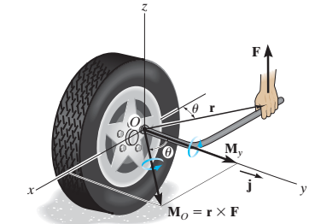
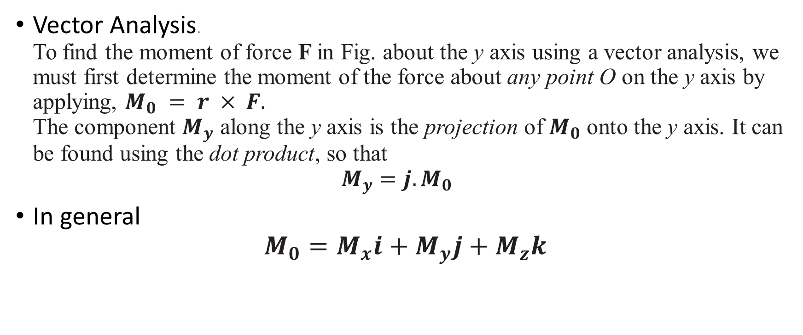
Vector Analysis. To find the moment of force F in Fig. about the y axis using a vector analysis, we must first determine the moment of the force about any point O on the y axis by applying, $M_{0} = r × F.$ The component $M_{y}$ along the y axis is the projection of $M_{0}$ onto the y axis. It can be found using the dot product, so that $M_{y}=j.M_{0}$
In general $M_{0}=M_{x}i+M_{y}j+M_{z}k$

Slide 18
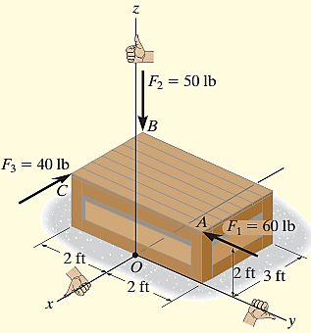
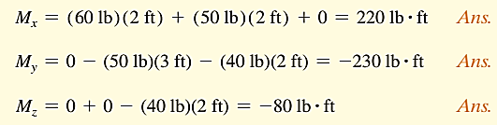
Determine the resultant moment of the three forces in Fig. about the x axis, the y axis, and the z axis.

Slide 19



Moment of a line
$$M_{L}=\overset{⃑}{M_{O}}.\hat{L}$$
$$4\hat{i}+3\hat{k}$$
$(30\hat{i}−40\hat{j}+60\hat{k}$). ($\frac{4\hat{i}+3\hat{k}}{\sqrt{4^{2}+3^{2}}}$)=$\frac{120+360}{5}=\frac{480}{5}$

Slide 20
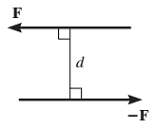
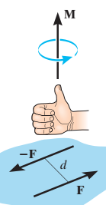
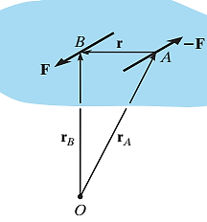
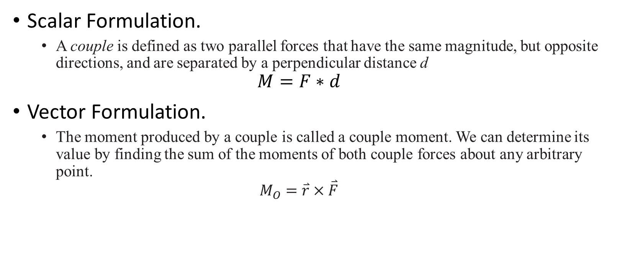
Moment of a Couple
Scalar Formulation.
A couple is defined as two parallel forces that have the same magnitude, but opposite directions, and are separated by a perpendicular distance d
$$M=F∗d$$
Vector Formulation.
The moment produced by a couple is called a couple moment. We can determine its value by finding the sum of the moments of both couple forces about any arbitrary point.
$$M_{O}=\overset{⃑}{r}×\overset{⃑}{F}$$

Slide 21
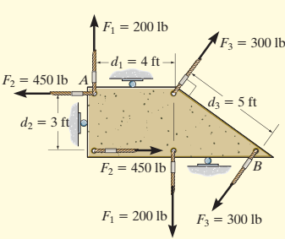
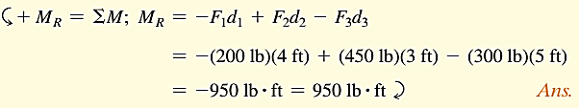
Equivalent Couples.
If two couples produce a moment with the same magnitude and direction, then these two couples are equivalent
Ex 4: Determine the resultant couple moment of the three couples acting on the plate in Fig

Slide 22
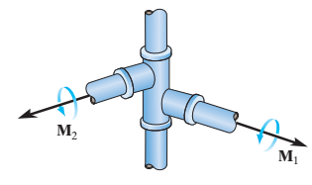
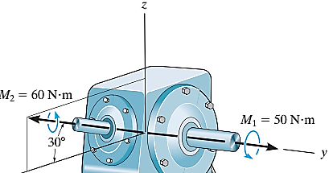
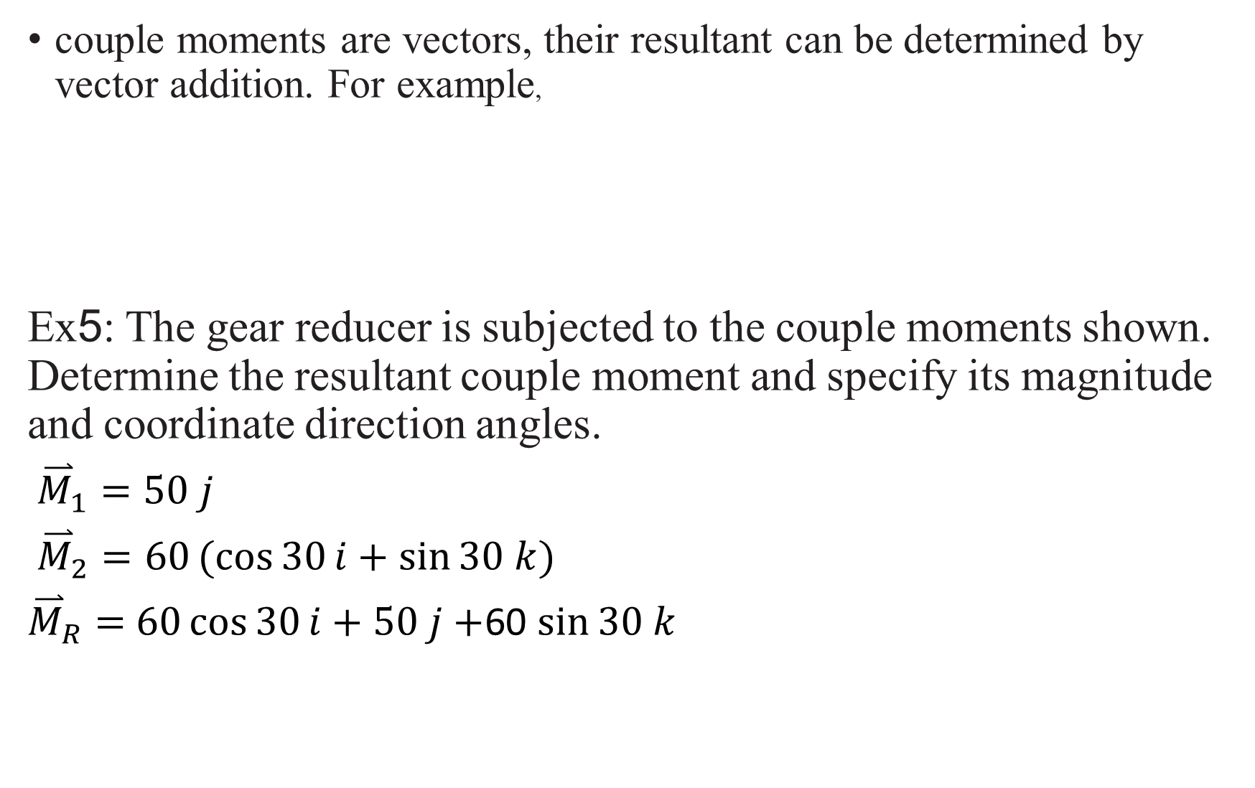
couple moments are vectors, their resultant can be determined by vector addition. For example,
Ex5: The gear reducer is subjected to the couple moments shown. Determine the resultant couple moment and specify its magnitude and coordinate direction angles.
${\overset{⃑}{M}}_{1}=50 j$
${\overset{⃑}{M}}_{2}=60(cos{30}i+\sin{30 k})$
${\overset{⃑}{M}}_{R}=$ $60\cos{30}i+50 j+$60 $\sin{30 k}$

Slide 23
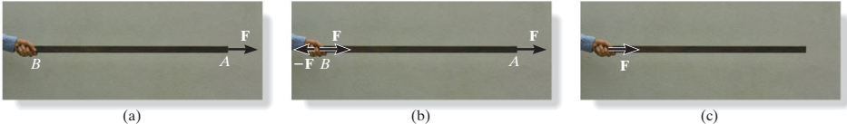
Simplification of a Force and Couple System
Sometimes it is convenient to reduce a system of forces and couple moments acting on a body to a simpler form by replacing it with an equivalent system, consisting of a single resultant force acting at a specific point and a resultant couple moment.
If the force is applied on
Force F has now been moved from A to B (line of action of the force ) without modifying its external effects on the stick; i.e., the reaction at the grip remains the same. This demonstrates the principle of transmissibility, which states that a force acting on a body (stick) is a sliding vector since it can be applied at any point along its line of action.

Slide 24
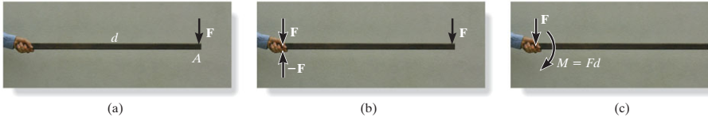
If F is applied perpendicular to the stick

Slide 25
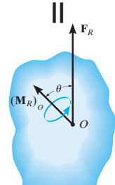
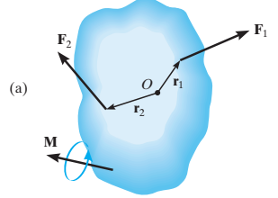
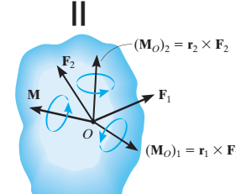
System of Forces and Couple Moments.
Using the above method, a system of several forces and couple moments acting on a body can be reduced to an equivalent single resultant force acting at a point O and a resultant couple moment. For example

Slide 26
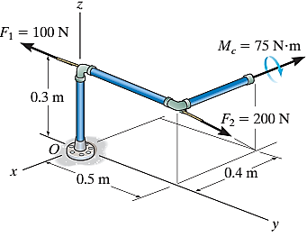
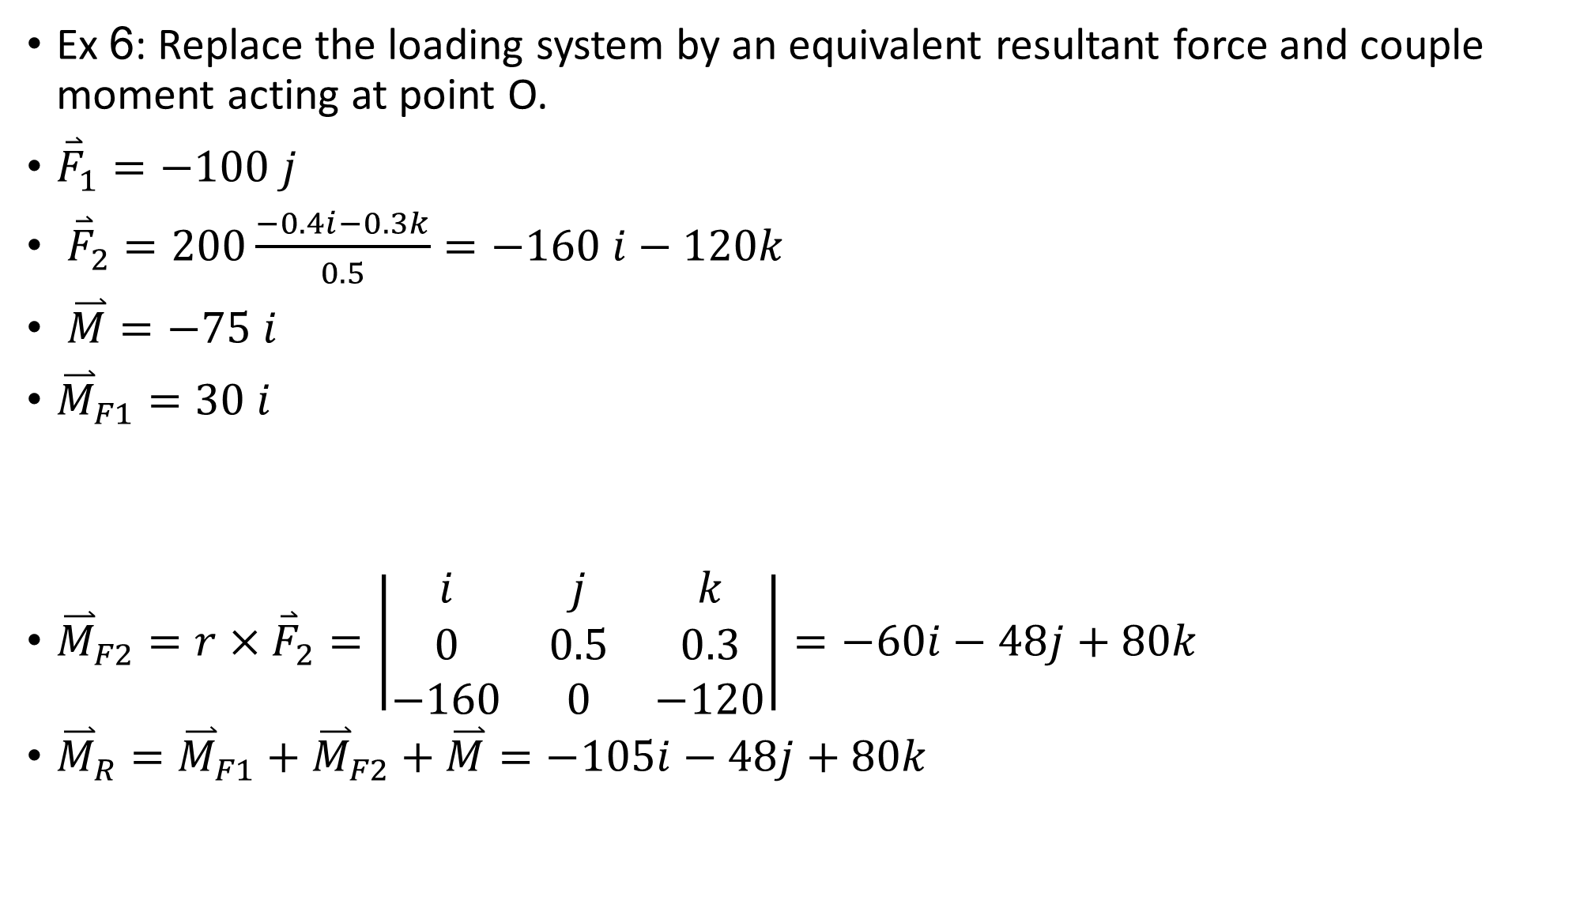
Ex 6: Replace the loading system by an equivalent resultant force and couple moment acting at point O.
${\overset{⃑}{F}}_{1}=−100 j$
${\overset{⃑}{F}}_{2}=200\frac{−0.4i−0.3k}{0.5}=−160 i−120k$
$\overset{⃑}{M}=−75 i$
${\overset{⃑}{M}}_{F1}=30 i$
${\overset{⃑}{M}}_{F2}=r×{\overset{⃑}{F}}_{2}=\left|\begin{matrix}i & j & k \\ 0 & 0.5 & 0.3 \\ −160 & 0 & −120\end{matrix}\right|=−60i−48j+80k$
${\overset{⃑}{M}}_{R}={\overset{⃑}{M}}_{F1}+{\overset{⃑}{M}}_{F2}+\overset{⃑}{M}=−105i−48j+80k$

Slide 27
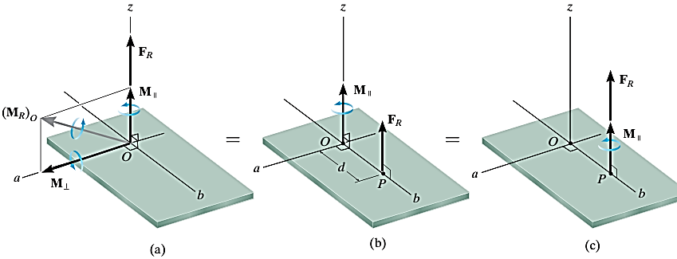
Reduction to a Wrench

Slide 28
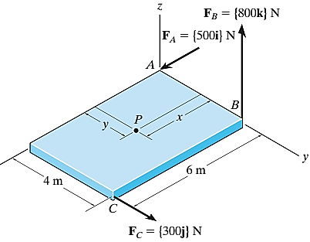
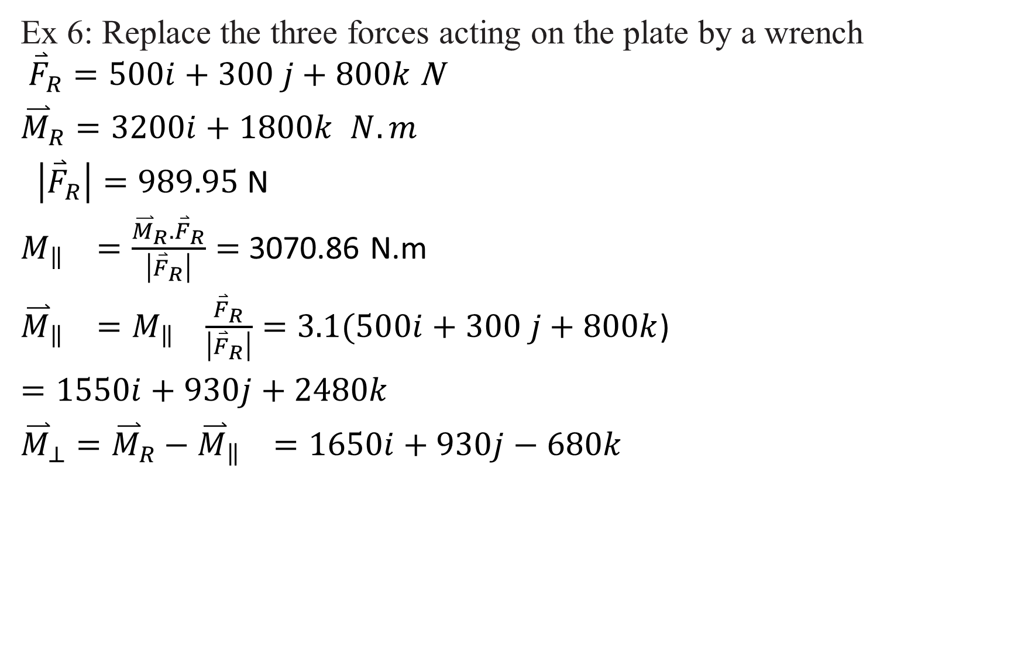
Ex 6: Replace the three forces acting on the plate by a wrench ${\overset{⃑}{F}}_{R}=500i+300 j+800k$N
${\overset{⃑}{M}}_{R}=3200i+1800k$ $N.m$
$\left|{\overset{⃑}{F}}_{R}\right|=989.95$ N
$M_{\left\|\right.}=\frac{{\overset{⃑}{M}}_{R}.{\overset{⃑}{F}}_{R}}{\left|{\overset{⃑}{F}}_{R}\right|}=$ 3070.86 N.m
${\overset{⃑}{M}}_{\left\|\left.\right.\right.}=M_{\left\|\right.}$ $\frac{{\overset{⃑}{F}}_{R}}{\left|{\overset{⃑}{F}}_{R}\right|}=\text{3.1}\text{(}500i+300 j+800k$)
$=1550i+930j+2480k$
${\overset{⃑}{M}}_{⊥}={\overset{⃑}{M}}_{R}−{\overset{⃑}{M}}_{\left\|\left.\right.\right.}=1650i+930j−680k$

Slide 29
Thank you
Dr Abdullah Zaher

